Slide 1
Testing Predictions of Stream Condition Index from a Spatial Stream Network Model Using Spatially Balanced Probabilistic Survey Data
Michael G. McManus, U.S. EPA
mcmanus.michael@epa.gov
The views expressed in this presentation are those of the author and do not necessarily represent the views or policies of the U.S. Environmental Protection Agency.
1

Slide 2
2
Research Question
How well does a spatial stream network model predict stream condition on an independent data set?
Notes:
Two things are cool about this question. First, we already know the answer. In the ideal world the correlation between observed “true” values and predicted values would be 1. But this is ecology, so we know that’s not going to be the case. Second, ongoing probabilistic monitoring provides the independent data set. This question needs to be answered before we start thinking of ecological forecasting.

Slide 3
Outline
Question and Outline
Virginia Department of Environmental Quality ProbMon Stream Data
Virginia Stream Condition Index (VSCI) in the James River Watershed
Observed vs Predicted VSCI: Small Multiple Maps and Scatter Plots
Spatial Stream Network (SSN) Models and Tweaks
Watershed Conclusions and Predictions
SSN2: The Movie, Acknowledgements, and a Caution
3
Notes:
Outline

Slide 4
II. Virginia DEQ
Spatially balanced probabilistic monitoring sites sampled from 2001-2018
11 Basins
806 Sites
Stratified by Strahler stream order 1-6
4
Notes:
Wadeable streams. Our focus is on the slate blue polygon of the James River basin.

Slide 5
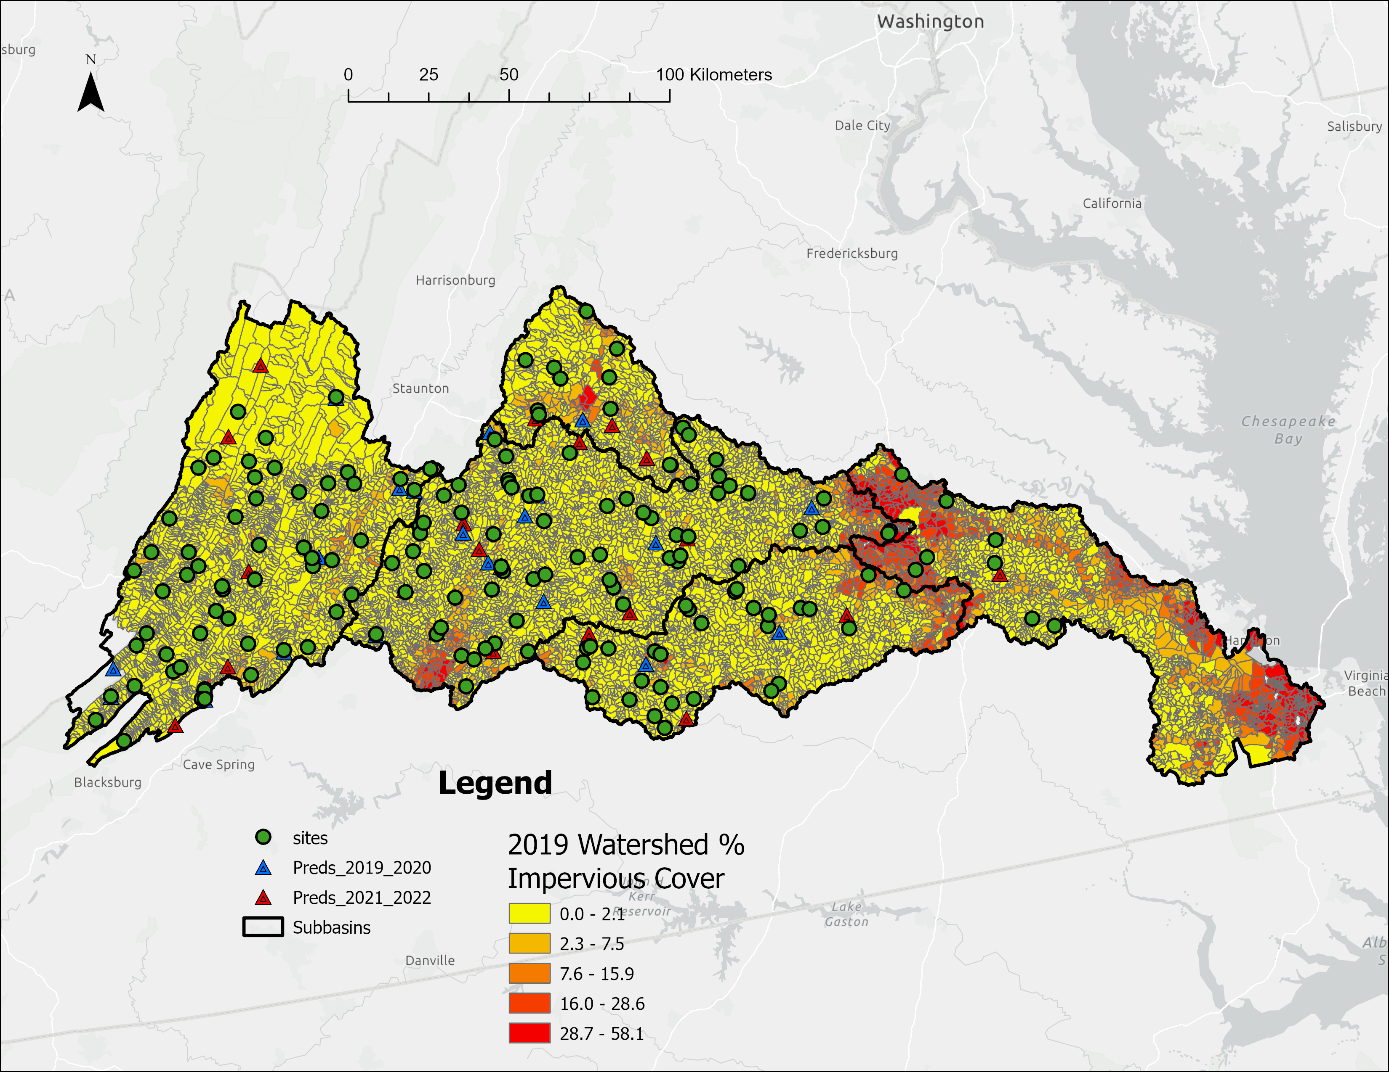
III. James River Watershed
Middle James (JM)
Upper James (JU)
Rivanna River (JR)
Lower James (JL)
Appomattox River (JA)
5
Notes:
Zoom into the James River basin. Sites distributed over 5 subbasins, black outlines and gray callouts: James Upper, James Middle, James Rivanna, James Appomattox, and James Lower.

Slide 6
III. Metrics of Virginia Stream Condition Index (VSCI)
Metric | Category | Response to Stress
Total Taxa | Taxonomic Richness | Decrease
Ephemeroptera, Plecoptera, Trichoptera (EPT) Taxa | Taxonomic Richness | Decrease
% Ephemeroptera | Composition | Decrease
% Plecoptera + Trichoptera - Hydropsychidae | Composition | Decrease
% Scrapers | Trophic Group | Decrease
% Chironomidae | Composition | Increase
% Top 2 Dominant | Diversity | Increase
Hilsenhoff Biotic Index (HBI Family Biotic Index) | Tolerance | Increase
6
Notes:
At those sites VDEQ collects benthic macroinvertebrates that are used to calculate these metrics for the Virginia Stream Condition Index, VSCI

Slide 7
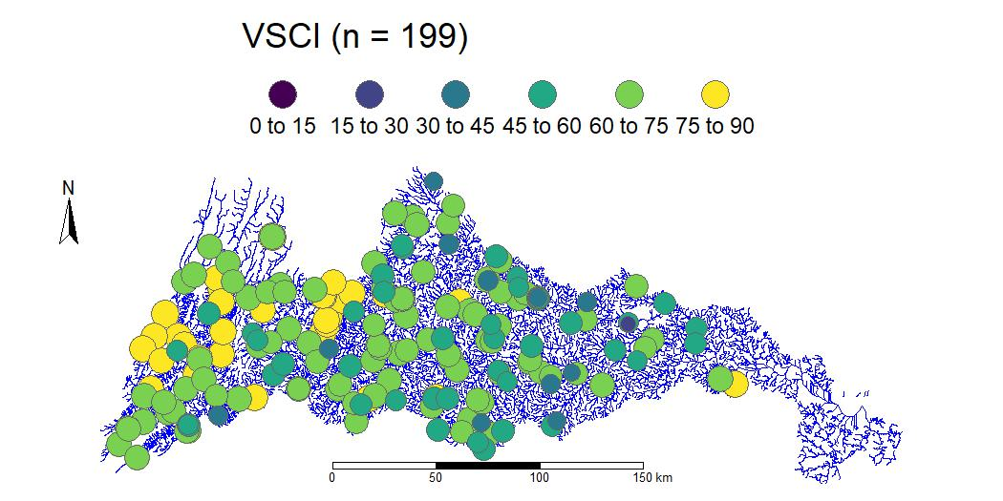
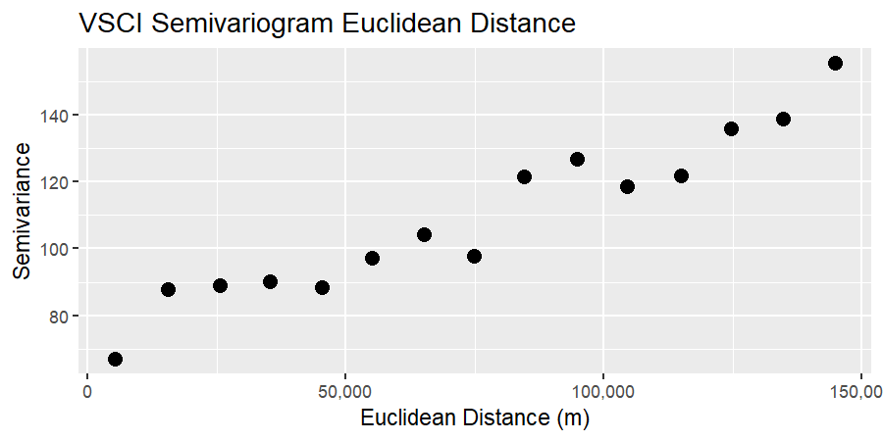
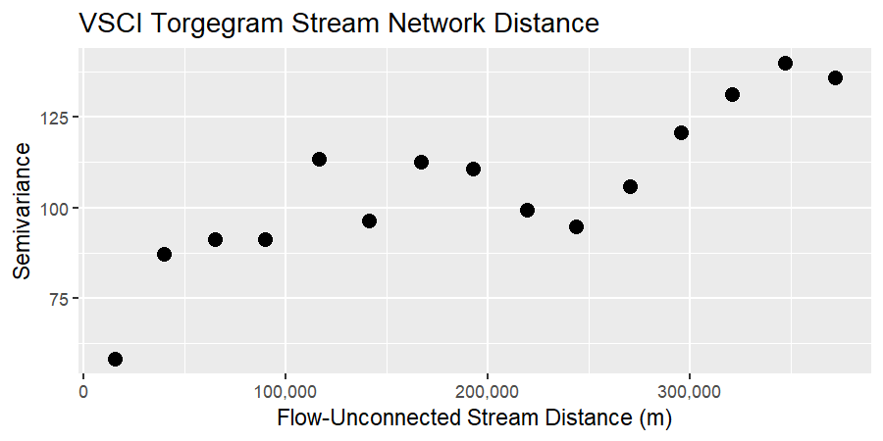
III. James River Virginia Stream Condition Index 2001-2018
7
Notes:
See a gradient of yellow and light green in west shifting to darker green and blue as move east. Higher scores indicate better ecological condition. Evidence of spatial autocorrelation in semivariogram and Torgegrram. Semivariogram, for Euclidean distances, and Torgegram, for stream network distances, are meant to diagnose if sites that are near each other resemble each other in stream condition index.

Slide 8
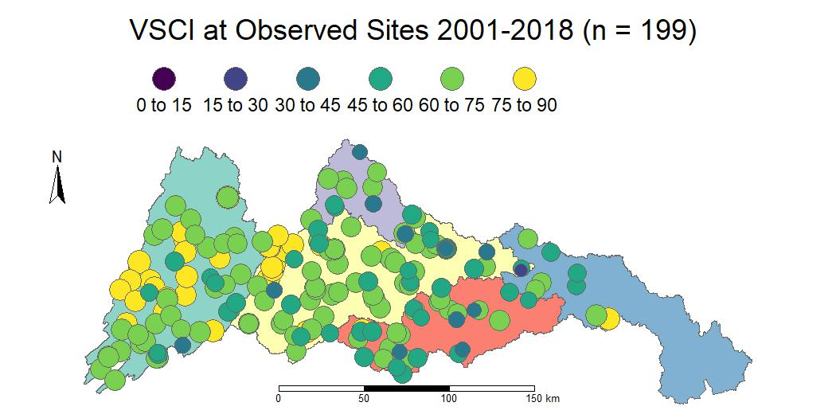
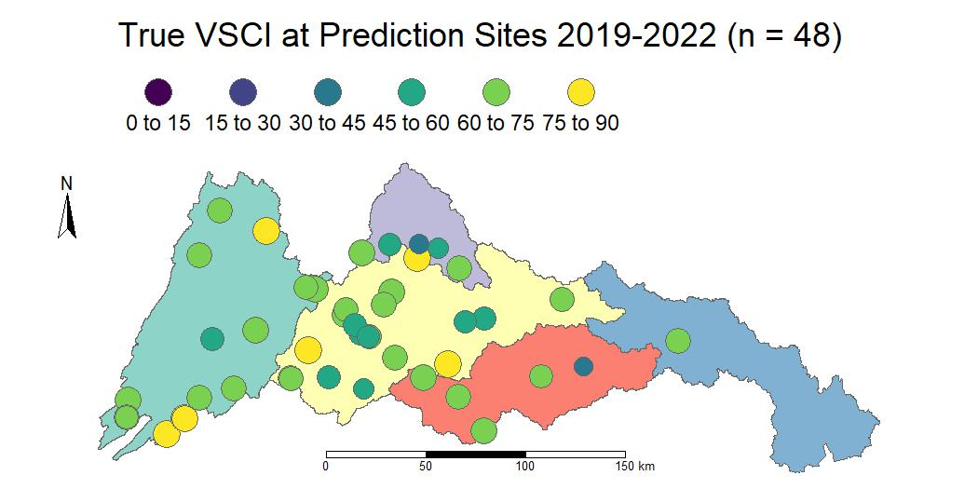
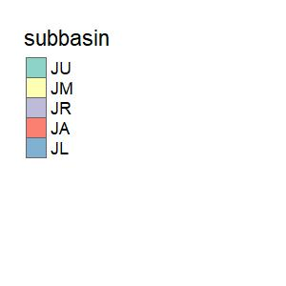
IV. Top: Observed sites used in modeling. Bottom: Predicted sites used to independently test the model by comparing “true” VSCI to predictions
8
Notes:
Start of multiple maps. At those sites VDEQ collects benthic macroinvertebrates that are used to calculate these metrics for the Virginia Stream Condition Index, VSCI. This and the following 2 slides have a top and bottom maps, sequentially the bottom map will move up to the top so another comparison can be made. Here we are comparing the 199 observations used to build the spatial stream network model to the 48 independent observations from 2019-2022 to test the model predictions.

Slide 9
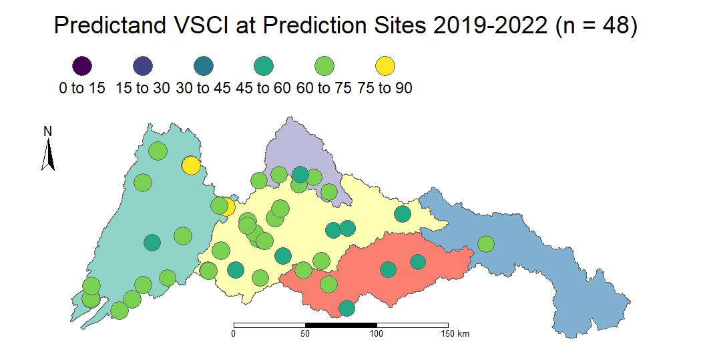
IV. Top: Predicted sites used to independently test the model by comparing “true” VSCI to predictions Bottom: Predicted VSCI from SSN model
9
Notes:
So, the “true” VSCI observations from the predicted sites are at the top, and we now compare them to the predictions from the SSN model.

Slide 10
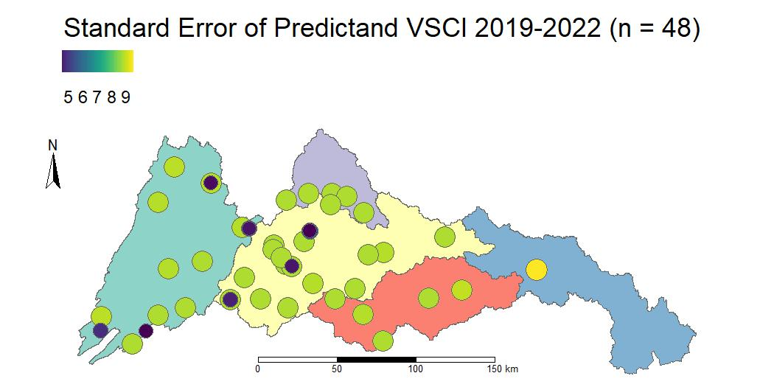
IV. Top: Predicted VSCI from SSN model Bottom: Predicted VSCI Standard Error from SSN model
10
Notes:
The predictions are now the top map, and the standard error of those predictions the bottom map. The small dark colored sites are the 7 trends stations, versus the much larger standard errors from the status, or one-time only visits. We have been looking at spatial distributions, and now we turn to statistical distributions of the data.

Slide 11
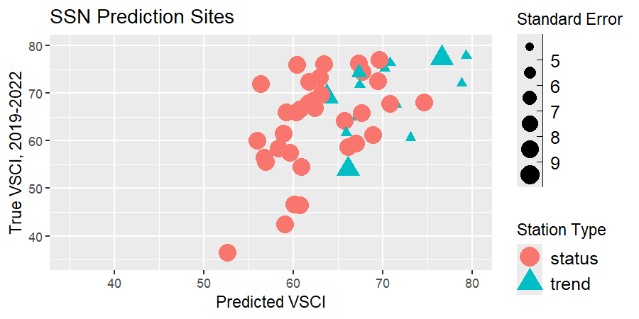
IV. Predicted VSCI and True VSCI by Station Type
11
Notes:
A scatter plot of predicted VSCI on the X axis and true VSCI on the Y axis.

Slide 12
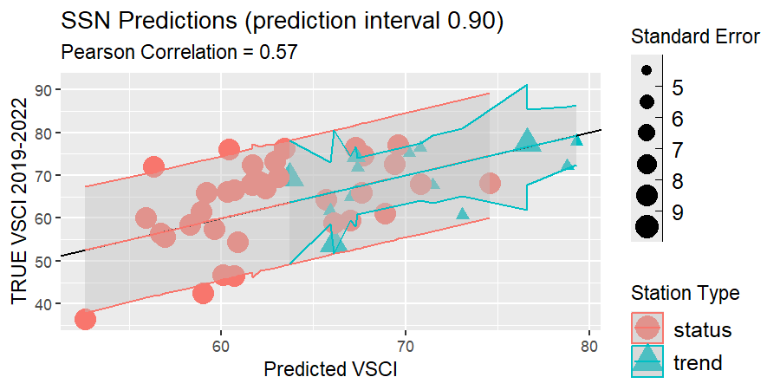
IV. VSCI Prediction Interval and Correlation
12
Notes:
Now, added the prediction interval lines, which are function of the prediction standard errors. The interval for trend stations tends to be smaller than status stations. Added a 1:1 and can see that few point fall on that and correspondingly the Pearson correlation of 0.57.

Slide 13
V. Predictor Variables and Variance Components
Predictor | Estimate | Standard Error
Intercept | 29.4 | 5.53
Watershed Impervious Surface | -3.06 | 0.54
Watershed Elevation | 0.01 | 0.003
Nearest Upstream Waterbody | 0.17 | 0.08
Dissolved Oxygen | 1.37 | 0.50
Lower James Subbasin (JL) | 10.1 | 3.36
Variance Components | Proportion of Variance
Covariates | 0.37
Tail Up Dependent Error | 0.02
Euclidean Dependent Error | 0.50
Nugget (Independent Error) | 0.11
13
Notes:
Here is the SSN model of the 199 observations that led to the predictions. All the predictor estimates have slopes that differ from zero. See some expected relationships.

Slide 14
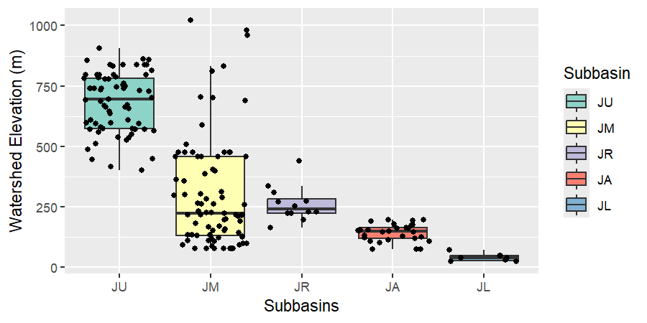
V. Watershed Elevation by Subbasin (n=199)
14
Notes:
The boxplots are hydrologically arranged as on the pervious maps. Boxplot for modeled observations, with black dots the jittered values for each subbasin. We have a lot of observations in the upper James, greenish color, and those elevations have a very different distribution than the other 4 subbasins. We can make a minor adjustment to the SSN model to acknowledge this elevation distribution.

Slide 15
V. Rivers and Streams form a Continuous Network . . .
BUT, that network passes through distinct regions
Set a partition factor of the Upper James vs other subbasins
Setting this assumes that observations from the Upper James are uncorrelated with the other subbasins
Better model fit and performance
Model | Akaike Information Criterion corrected | Root Mean Square Prediction Error | Squared Correlation between Predicted and True Values
With Partition Factor | 1406 | 8.31 | 0.42
Without Partition Factor | 1422 | 8.45 | 0.40
15
Notes:
Better fit based on AICc,, and better performance based on smaller RMSPE and higher cor2

Slide 16
Using and independent data set, how well does a spatial stream network model predict stream condition data set?
VI. Watershed Conclusions
Broad landscape stressor + Network-specific stressor + On-site stressor + Geophysical covariate, along with spatial random effects, did a reasonable job predicting stream condition
Move to a more prospective spatial stream network predictions by making VSCI predictions before the monitoring season
16

Slide 17
Using and independent data set, how well does a spatial stream network model predict stream condition data set?
VI. Conclusions on Predictions
Ecologically, a correlation of ~ 0.60 between observed true values and predicted values is pretty good
Prediction standard errors tended to be smaller for trend stations, which have more observations, than status stations
An improved model was obtained by using a partition factor to make the model more realistic
17

Slide 18
Spatial Stream Network Analysis is a trilogy:
VII. SSN2: The Movie
Exploratory Spatial Data Analysis
Spatial Stream Network Modeling
Spatial Stream Network Predictions
Director’s Cut for the code for that trilogy is at this GitHub site:
https://github.com/USEPA/vdeq-stream-condition-predictions
18
Notes:
Like a good trilogy, spatial stream network analysis has 3 parts: ESDA, modeling, and prediction.

Slide 19
Biologists and field crews at Virginia Department of Environment Quality, especially Jason Hill and Emma Jones. Ellen D’Amico, GIS Analyst, at Pegasus Technical Services Inc. Travis Linscome-Hatfield, Statistician, at Neptune and Company Marc Weber, Geographer, for StreamCat database and Tools, and Michael Dumelle, Spatial Statistician, for R package SSN2, both at U.S. EPA ORD.
VI. Acknowledgements
19

Slide 20
"GIS and kriging are excellent tools, when properly applied to suitable data sets. However, when applied to data that are not regionally representative, the results, while attractive in appearance, will most likely represent an unreliable and misleading assessment of regional condition. Any biases in the data set will be transferred to a biased ‘picture’ in the combined GIS/kriging presentation."
VI. A Caution about Spatial Predictions
Peterson, S.A., Urquhart, N.S. and Welch, E.B., 1999. Sample representativeness: a must for reliable regional lake condition estimates. Environmental science & technology, 33(10), pp.1559-1565.
20

